Slide 1
RANDOM FORESTS
PRESENTER: MITHUN ALVA

Slide 2
AGENDA
Definition
Origin of Random Forests
The Algorithm
Advantages, Shortcomings and Applications of Random Forests
An example of using Random Forests (using R)
Readings/ References for further review

Slide 3
DEFINITION
Random Forests are an ensemble learning method for classification & regression
Ensemble methods are made up of multiple learning algorithms, which collectively provide better prediction as compared to any single one of them.
They are made up of multiple decision trees
The output is
the mode of the predicted classes ( in case of classification), and
the mean of the prediction value ( in case of regression) provided by the individual trees.

Slide 4
ORIGIN OF RANDOM FORESTS
Algorithm developed by Leo Breiman and Adele Cutler.
Leo Breiman
January 27, 1928 – July 5, 2005
Professor Emeritus of Statistics at University of California, Berkeley.
Adele Cutler is his long-time collaborator and former Ph.D student.
“Random Forests” is their trademark.

Slide 5
ORIGIN OF RANDOM FORESTS
Decision Tree Models
Involve segmenting the predictor space into a number of simple regions.
Since the rules to segment the space can be summarized in a tree, these models are called “Decision Tree” models.
Can be applied to both ‘classification’ and ‘regression’ problems.

Slide 6
ORIGIN OF RANDOM FORESTS
Decision Tree Models: An Example
Predicting the ‘Choice’ (of car model) chosen based on:
Expense: Expense tolerance of the subject
Gender : Gender of the subject
PreviousOwnership: Number of cars previously owned by subject
Sample training dataset
Gender | Previous Ownership | Expense | Choice
Male | 0 | Less | Yaris
Male | 1 | Less | Yaris
Female | 0 | Less | Yaris
Male | 1 | Less | Yaris
Female | 1 | More | Tundra
Male | 2 | More | Tundra
Female | 2 | More | Tundra
Female | 1 | Less | Prius
Male | 0 | Average | Prius
Female | 1 | Average | Prius

Slide 7
ORIGIN OF RANDOM FORESTS
Process of building the tree
Link in ‘References’ section: Step-by-Step Decision Tree building
Key concept: Gini Index
Gini Index is a measure of node purity.
Calculated as Σ P_{j} * (1- Pj),
where Pj represents the proportion of observations in the “j^{th}” class
For our dataset, P_{j} values are:
And, the Gini Index is (0.4)*(0.6)+(0.3)*(0.7)+(0.3)*(0.7) = 0.66
Final tree:
Use Gini Index to calculate ‘Information Gain’ for each variable.
The variable providing the best ‘Information Gain’ is plotted on the tree. Repeat till a full tree is generated.
P(Yaris) | 0.4
P(Tundra) | 0.3
P(Prius) | 0.3

Slide 9
ORIGIN OF RANDOM FORESTS
Advantages of Decision Tree Models
Easy to interpret and explain
Implicitly perform variable screening
Variables associated with top few nodes are the most important
Require relatively less data preparation effort
Can handle a mix of categorical and continuous variables
Can handle missing values
Not sensitive to outliers
Scaling of parameters ( e.g. revenue in millions and loan age in years in the same dataset) is not necessary.
Can handle non-linear relationships.

Slide 10
ORIGIN OF RANDOM FORESTS
Shortcomings of Decision Tree Models
High Variance: If we split the training data into two parts at random and fit a decision tree to both halves, we could get very different trees.
Tend to favor categorical predictors with many levels. Variables with a large number of levels can cause severe overfitting.
‘Bagging’ attempts to address the above shortcomings.

Slide 11
ORIGIN OF RANDOM FORESTS
Bagging (also known as ‘bootstrap aggregation’)
From your full dataset, take a sample , generate a tree and obtain predictions.
Repeat with a different sample, from the same dataset. The new tree will typically make different predictions.
Continue sampling and generating trees in this manner till about 500 trees are obtained.
This process is called “Bagging”.

Slide 12
ORIGIN OF RANDOM FORESTS
‘Out of Bag’ (OOB) Data
If we sample from available data and build a tree, we already have holdout data available for that tree. This data is referred to as “Out of Bag” data.
Every tree grown has a different holdout sample
Every record in the full dataset is “in bag” for some trees(about 2/3rd) and “out of bag” for the other trees.

Slide 13
ORIGIN OF RANDOM FORESTS
‘Out of Bag’ (OOB) Data
Suppose a given record was “in bag” for 375 trees and “out of bag” for the remaining 125 trees.
Predictions for this record could be generated using just the “out of bag” trees.
Always having OOB data means we can effectively work with relatively small datasets.

Slide 14
ORIGIN OF RANDOM FORESTS
5 1 1 4 1
Bagging
The sampling method here is bootstrap sampling
Each time the # of observations in the sample = # of observations in the training data
However, sampling is done with replacement.
Therefore all observations will not be present in the chosen sample
Example: if the training data is {1,2,3,4,5}
Sample 1 could be {5,1,1,4,1}
Sample 2 could be {2,1,5,3,3}
Sample 3 could be {1,2,3,2,5}
…and so on

Slide 15
ORIGIN OF RANDOM FORESTS
Bagging & Predictor subset-ing
Trees in the Bagger were found to be too similar to each other
To address this, Breiman introduced randomness into the actual tree growing as well
Normally, all possible predictors are evaluated for their ability to form a node in the tree and partition the data in the best possible manner.
Instead, every time we are forming a node, a subset of the predictors is considered.
From among these predictors, the one providing the best partitioning is used to form the node.
A new random subset of predictors is chosen to build each node.
‘Random Forests’ combines the concepts of decision trees, bagging and predictor subset-ing.

Slide 16
ORIGIN OF RANDOM FORESTS
Breiman and Cutler suggested using one of the following rules to form the subset of predictors.
Predictors(N) | sqrt(N) | 0.5*sqrt(N) | 2*sqrt(N) | Log₂(N)
100 | 10 | 5 | 20 | 7
1,000 | 31 | 15.5 | 62 | 10
10,000 | 100 | 50 | 200 | 13
100,000 | 316 | 158 | 632 | 17
1,000,000 | 1000 | 500 | 2000 | 20

Slide 17
ALGORITHM

Slide 18
ADVANTAGES OF RANDOM FORESTS
Automatic identification of important predictors
Good for wide data; provide good accuracy and generate reliable predictor importance rankings.
Resistant to over training.
Each decision tree is independent. Therefore trees can be grown on different cores or different computers, allowing for quicker analysis.

Slide 19
SHORTCOMINGS OF RANDOM FORESTS
Suited for wide datasets with only a moderate number of rows. Breiman recommends the use of other tools for larger datasets.
Large memory needed to store built models.
Overfitting might be seen with noisy data.

Slide 20
APPLICATIONS OF RANDOM FORESTS
Online targeted marketing
Credit card fraud detection
Text analytics
Credit risk and insurance risk
Retail Sales prediction
Biological & Medical Research
Manufacturing Quality Control

Slide 21
EXAMPLE
R packages used in example
randomForest: Breiman and Cutler's random forests for classification and regression.
rpart: Recursive partitioning for classification, regression and survival trees. An implementation of most of the functionality of the 1984 book by Breiman, Friedman, Olshen and Stone.
caret: Miscellaneous functions for training and plotting classification and regression models.

Slide 22
EXAMPLE
Titanic dataset https://www.kaggle.com/c/titanic
Predictors :
pclass Passenger Class (1 = 1st; 2 = 2nd; 3 = 3rd)
name Name
sex Sex (“female”, “male”)
age Age ( in years)
sibsp Number of Siblings/Spouses Aboard
parch Number of Parents/Children Aboard
ticket Ticket Number
fare Passenger Fare
cabin Cabin
embarked Port of Embarkation(C = Cherbourg; Q = Queenstown;
S = Southampton)

Slide 23
EXAMPLE
Titanic dataset
Response :
survived 0 = No; 1 = Yes
Ask:
“predict which passengers survived the tragedy”

Slide 24
EXAMPLE
Additional features created:
Title:
Isolating ‘Titles” (i.e Col, Dr, Lady, Master, Miss, etc…) from the ‘Name’ field.
converting them into “Mlle”, “Sir” or “Lady”
FamilyID
Large families might have had trouble getting to lifeboats together
SibSp+Parch+1 will give Family Size
Last Name like “Johnson” is common.
Join with Last Name with count to uniquely identify Family Name & Size.

Slide 25
EXAMPLE
Data Preparation:
‘randomForest’ package in R cannot handle missing values
‘Age’ has 263 missing values
Could be replaced by mean/median of all other non-missing values
Another way is to use a decision tree & do a prediction on missing values
tree is build using the ‘rpart’ package
‘Embarked’ has missing values in two rows
Replace them with ‘S’.
Nearly 70 % of the population embarked at Southampton
‘Fare’ had 1 missing value
Replace with median of non-missing fare values

Slide 26
EXAMPLE
Data Preparation:
Random Forests in R can only digest factors with up to 32 levels
FamilyID has a larger number of levels
Create a new feature called FamilyID2
Equal to “Small” if FamilySize < =3, and FamilyID otherwise

Slide 27
EXAMPLE
Install the ‘randomForest’ package in R
Install.packages (‘randomForest’)
To obtain same results every time you run the code, use ‘set.seed’
Syntax: fit=
randomForest(as.factor(Survived) ~ Pclass + Sex + Age + SibSp + Parch + Fare + Embarked + Title + FamilySize +FamilyID2,
data=train,
importance=TRUE, # enables inspection of variable importance
ntree=2000) # number of tree to grow. Default is 500

Slide 28
EXAMPLE
Inspect variable importance plots
varImpPlot(fit)
Will tell us which variables have the highest impact on the predictive ability of the model
Variable associated with the most decrease of the appropriate measure has the highest impact.

Slide 29
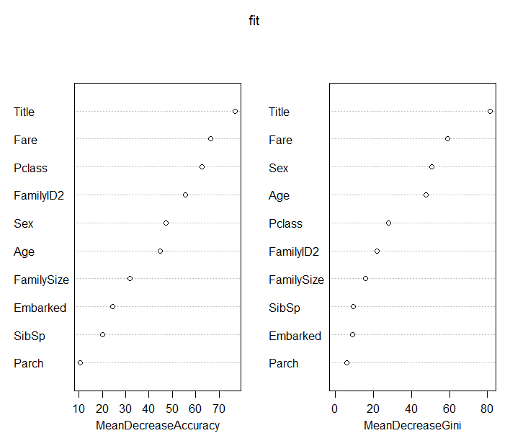
EXAMPLE
‘Title’ has the strongest impact, in terms of both Accuracy and Gini Index
Added features ‘FamilyID2’ and ‘FamilySize’ have substantial impact

Slide 30
EXAMPLE
Additional parameters for model
randomForest(as.factor(Survived) ~
Pclass+Sex +Age + SibSp +Parch + Fare + Embarked +Title + FamilySize +FamilyID2,
data=train,
importance=TRUE, # enables inspection of variable importance
ntree= , # number of tree to grow. Default is 500
mtry= , #number of variables selected at each node.
#Default is square root of the number of variables
nodesize= , #minimum size of terminal nodes. Setting this to the value ‘k’ #means that no node with fewer than k cases will be split.
#Default =1 for classification and 5 for regression
………..)

Slide 31
EXAMPLE
Performance Evaluation
Confusion Matrix
Accuracy = (491 + 250)/(549+342) = 0.8316
95% CI : (0.8054, 0.8557)
 | Predicted
Actual | 0 | 1
0 | 491 | 92
1 | 58 | 250
 | 549 | 342

Slide 32
EXAMPLE
Tuning the Random Forests model
Objective is to find the best value of mtry (i.e. number of predictors chosen at each node)
tunefit= train(as.factor(Survived)~ .,
data=train1,
method="rf", # ‘rf’ stands for random forest
metric="Accuracy", # what are we trying to improve
tuneGrid=data.frame(mtry=c(2,3,4))) # set of values to be considered

Slide 33
EXAMPLE
Tuning the Random Forests model
Objective is to find the best value of mtry (i.e. number of features chosen at each node)
mtry Accuracy
2 0.8236414
3 0.8310338
4 0.8302738

Slide 34
EXAMPLE
Apply model to test data
Prediction = predict (tunefit, newdata =test)
Will give you predictions for ‘Survival’. ‘0’ and ‘1’ values

Slide 35
REFERENCES
Leo Breiman's Random Forests Page
An Introduction to Random Forest for Beginners: Salford Systems
Random Forests Lecture by Nando Freitas, University of British Columbia
Random Forests Lecture by Derek Kane
The Elements of Statistical Learning: Hastie, Tibshirani & Friedman
Introduction to Statistical Learning: James, Witten, Hastie and Tibshirani
Trevor Stephens: Titanic Dataset Analysis using R
Curt Wehrley: Titanic Dataset Analysis using R
randomForest package in R
rpart package in R
caret package in R
Step-by-Step Decision Tree building
Machine Learning Benchmarks and Random Forest Regression, Mark Segal

